Slide 1
Intro to Arduino
Sean Murphy
Tampa Hackerspace
http://goo.gl/e97Eep

Slide 2
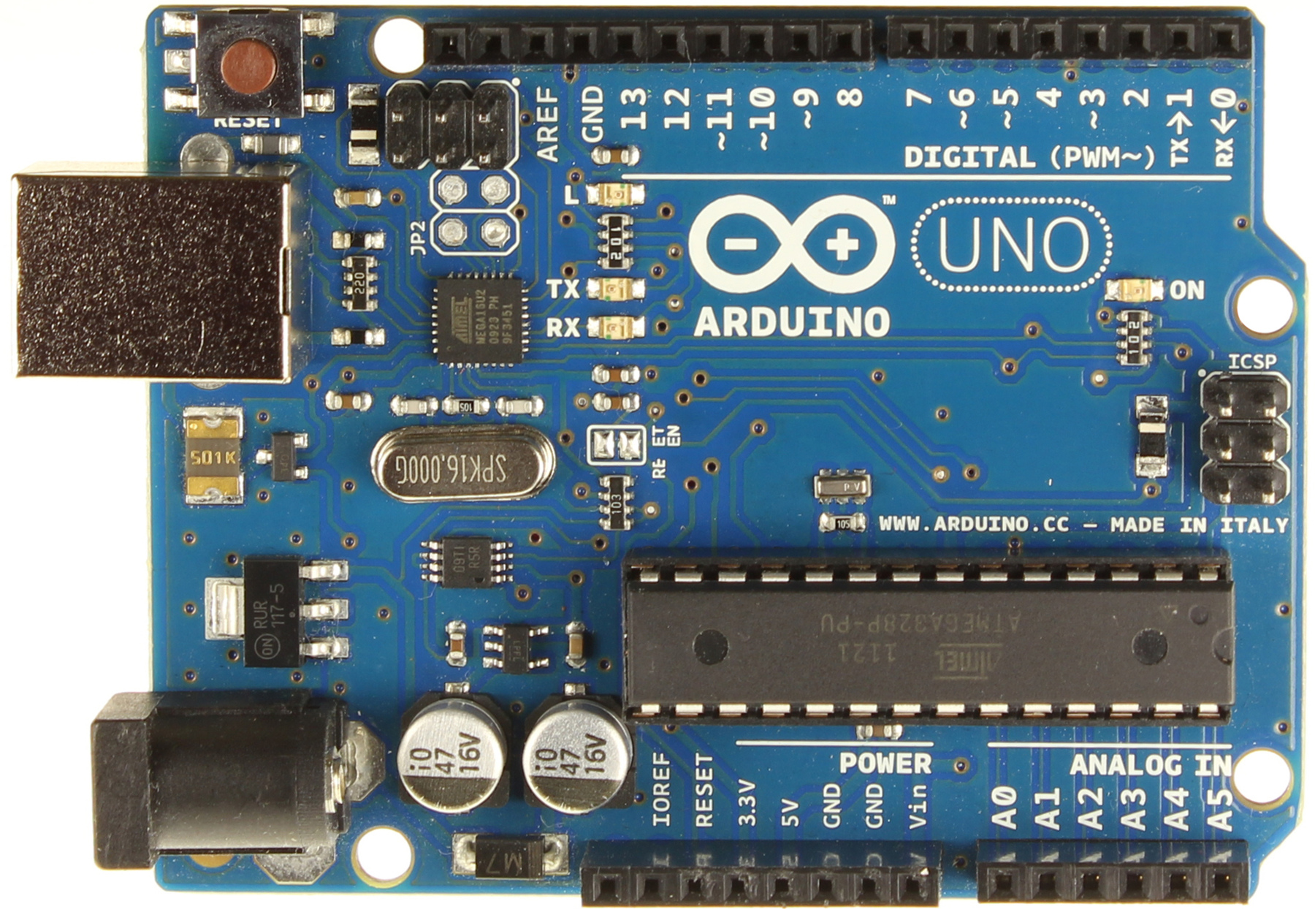
Arduino Uno R3

Slide 3
What is Arduino
“Arduino is a tool for making computers that can sense and control more of the physical world than your desktop computer.”
It is a device that executes a program to interface with real-world electronics (everything from switches and LEDs to wireless transceivers and motors)

Slide 4
What exactly does that mean?
Example: Skittle color sorter
Arduino controls motor to dispense skittle,
Reads color sensor to determine color,
Lights up RGB LED to tell people the color,
Controls a servo motor to place the skittle into the correct cup by color
Prints text to an LCD screen to keep a running total of each color

Slide 5
Capabilities and Hardware
Processor: atmega328p, 16MHz 8-bit
32KB flash, 2KB RAM, 1KB EEPROM
Analog input pins
Digital input/output pins
PWM pseudo-analog output
I2C, SPI, and serial communication

Slide 6
Other Arduinos and ‘duinos
Various other boards with different capabilities such as more I/O, Wifi, Bluetooth, Ethernet, wearable, etc.
Non-official “clones” such as SFE’s RedBoard
Clones are cheaper but run same software
Other clones are designed to be smaller and cheaper to leave permanently in electronics like PJRC’s Teensy or the Digistump’s Digispark

Slide 7
Electrical Specs
Digital output pins can supply 0V (GND) or 5V at up to 35mA – enough to drive about two LEDs but not a motor
Digital input pins sense either a LOW (0V) or a HIGH (5V)
Analog input pins sense a value between 0 (0V) and 1023 (5V) giving a resolution of about 5mV

Slide 8
Pulse Width Modulation
Some pins can be configured for PWM
PWM simulates an analog output value by quickly changing back and forth from LOW to HIGH (around 500 times per second)
This can be used for brightness control of an LED or setting the speed of a motor (with motor driver)

Slide 9
Timer/Counters
Special hardware features of the atmega328p
Used for timekeeping, delays, and PWM
Also applicable to oodles of more advanced topics

Slide 10
Other Advanced Features
Interrupts
Sleep
Watch Dog Timer
I2C SPI device control

Slide 11
How do I make it do things?
The Arduino language is essentially C with some C++ features
You write code with the Arduino Integrated Development Environment (IDE) then
Compile and upload the code to the Arduino
The Arduino then executes the code

Slide 12
But first, an intro to C/C++
This won’t teach you everything.
Sorry. There isn’t time for that.

Slide 13
Variables
char – “character” 8-bits holds -128 to 127
unsigned char or byte – 8-bits holds 0 to 255
int – “integer” 16-bits holds -32768 to 32767
unsigned int – 16-bits holds 0 to 65535
long – 32-bits holds ±2 billion
float – 32-bits holds 6-7 digits of a number
String – stores text (large and slow)
And more…

Slide 14
Comparison
&& (and)
|| (or)
! (not)
== (equals)
!= (not equals)
< > <= >= (comparisons)

Slide 15
Operatiors
+ - * / (add, sub, mult, div)
= (assign) (int a = 3;)
% (modulo)
+= (compound addition) (a += 2;)
-= *= /= %=
++ (unary prefix/postfix increment)
-- (decrement)

Slide 16
Comments
// this is a single-line comment
/* this is a multi-line comment
I’m still in the comment
Still a comment
*/
Good code has good comments

Slide 17
Example so far
int a = 3; // a now holds 3
a = 7; // a now holds 7
a += 2; // a now holds 9
a--; // a now holds 8
--a; // a now holds 7
a = a * 2; // a now holds 14
a++; // a now holds 15

Slide 18
Conditionals
if (someCondition)
{
do this thing;
}
if (otherCondition)
{
do this;
}
else
{
do this instead;
}

Slide 19
For
for (initial condition; while this is true; do this each time)
for (int i = 0; i < 10; i++)
{
do something;
}
The above counts from 0 to 9

Slide 20
While
while (condition)
{
do something;
}
while will continue as long as condition is true. Use it to do something like wait on a button press

Slide 21
Other things
Do-while loops
Switch-case conditionals
Break, continue, return, goto
Never use goto

Slide 22
Arduino “main” functions
void setup()
{
// this runs once
}
void loop()
{
// this runs repeatedly
}

Slide 23
Arduino-specific commands
Each pin has a number (0 to 13 and A0 to A5)
Pins can be INPUT (0) or OUTPUT (1)
OUTPUT pins can be LOW (0) or HIGH (1)

Slide 24
digitalWrite
//digitalWrite(pinNumber, value);
int myPin = 13;
digitalWrite(myPin, HIGH);
digitalWrite(13, 1);
Both do the same thing

Slide 25
pinMode
pinMode(pinNumber, value)

Slide 26
digitalRead
int yada = digitalRead(13);
yada now has either a HIGH or LOW value

Slide 27
analogRead
int foo = analogRead(3); //pin A3
foo now stores somewhere between 0 and 1024

Slide 28
analogWrite
analogWrite(pinNumber, value);
value must range from 0 to 255
analogWrite(10, 127); // about 2.5V
Only works on pins 3, 5, 6, 9, 10, and 11

Slide 29
Timing
delay(timeInMilliseconds);
delayMicroseconds(number);
millis() returns time since restart
long now = millis();
while(millis() < now+13)
{
do something for 13 milliseconds
}

Slide 30
Serial Communication
Serial.begin(baudRate)
Serial.print( )
Serial.println( )
Serial.available()
Serial.read()
and others…
common baud rates are 9600, and 115200

Slide 31
Other built-in functions
tone(pin, frequency);
tone(pin, frequency, duration);
pulseIn(pin, value);
min(), max(), abs(), pow(), sqrt(), sin(), cos() …
random(max)
attachInterrupt()

Slide 32
Libraries
http://arduino.cc/en/Reference/Libraries
http://www.nongnu.org/avr-libc/user-manual/modules.html
Used for fancy premade functions or specific hardware. For example, using an LCD screen

